Slide 1
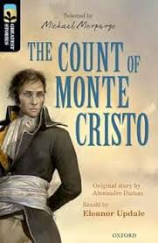
The Count Of Monte Cristo
Gjørt av: Silju, Sonju, Idu, Marius og Boas

Slide 2
Title and Author
The name of the novel is The Count of Monte Cristo. It was written January 15th 1846 by Alexandre Dumas. Alexander dumas was born in July 24th 1802 and died december 5th 1870. Alexandre Dummas has also written other books than "The Count Of Monte Cristo" fx The Three Musketeers.

Slide 3
Referat
The Count of Monte Cristo is the story of Edmond Dantes, also known as: The Count of Monte Cristo.
After being imprisoned and escaping the terrors of the Chateau d'if, he gets a new identity and fabulous wealth. But he has his mind set on taking revenge on those who had betrayed and imprisoned him.

Slide 4
Personer
The important bicharacters are Danglars, also known as Baron Danglars. He has a wife named Madame Danglars also known as Baroness Danglars.
Monsieur Morrel is an employer of Edmond and he has a son named Maximilian Morrel.
Louis Dantes is the father of Edmond.
Gaspard Caderousse, later an innkeeper,
Mercedes was engaged to Edmond but later on she married Fernand who is also known as her cousin they had a kid named Albert de Morcerf.
Monsieur de Villefort has a daughter named Valentine de Villefort he also has a wife named Madame de Villefort. His father was Noirtier.
Faria is a prisoner in the Chateau d`If,
Jacopo is a sailor who saved Edmonds life,
Franz was engaged to Valentine de Villefort and a wealthy friend of Albert de Morcerf,
Barrois was a servant of Noirtier.
The main character is Edmond Dantes and he had a fiancée called Mercedes. his father is Louis Dantes. Edmond was 19 when he went to jail for 14 years
Edmond was also known as: Lord Wilmore, Busoni, Sinbad the Sailor and The Count of Monte Cristo.

Slide 5
Relationship and community
The main character, Edmond Dantes is part of many communities and relationships. Fx Faria in the jail, and Monsieur Morrel on the ship and as his best friend. Mercedes as Edmond's fiancée, and Monsieur de Villefort who put him in jail for 14 years.
His best friend is Monsieur Morrel, and Jacopo becomes his most trusted servant
He has been alone for a couple of years when he was imprisoned.

Slide 6
Enviroment
The story takes place in Italy, and in France Paris, Marseille.
It takes place in the 18 hundreds.
It was in the Napoleon era, where all the wealthy people were in charge.

Slide 7
Narrator and narrative technique
The narrator is omniscient, meaning it knows everything. It knows what the characters are feeling, thinking and doing.

Slide 8
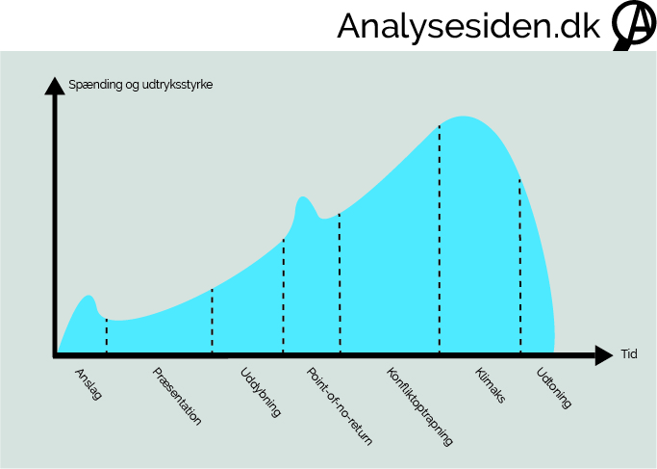
Composition
The novel is structured in the middle of the story and there is always something happening.
The novel is structured by the narrator model.

Slide 9
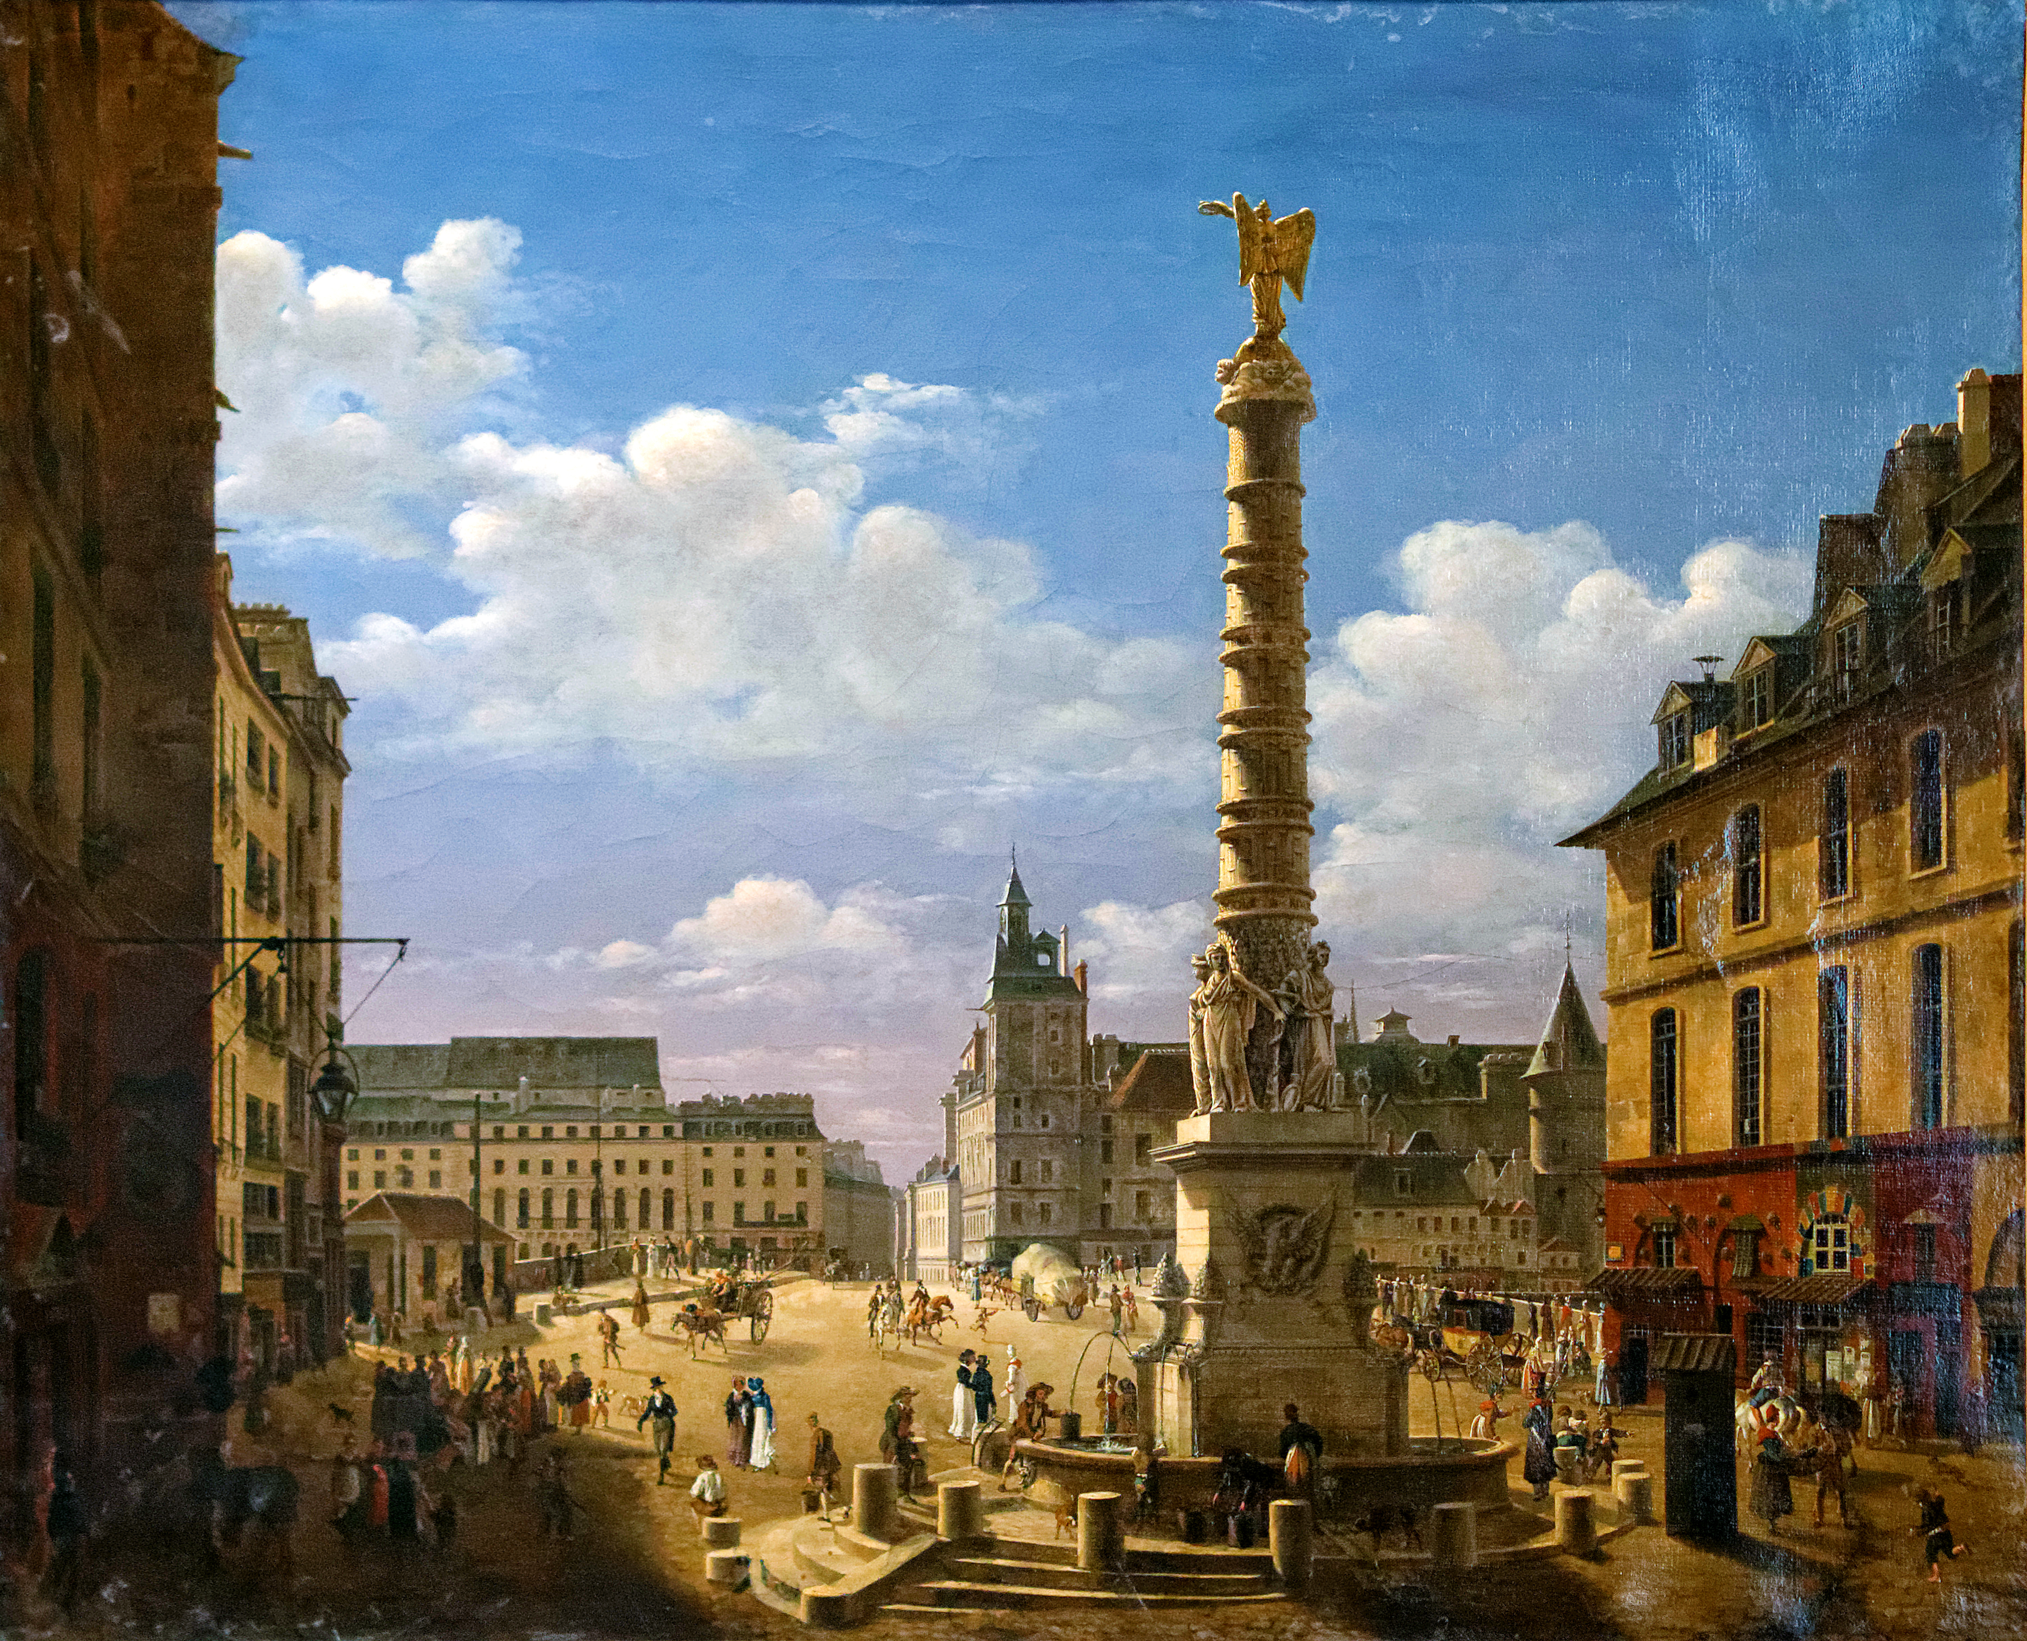
Motive and Theme
There are many themes, fx: love, crime, wealth, revenge a.s.o

Slide 10
Perspective
This story Reminds me of Anakin Skywalker in Starwars.
Because They met when they were young, And then someone who is evil tricked Anakin into joining them, and in Anakin's anger, he killed her. So when he became darth vader he wanted to kill his bestfriends.

Slide 11
Assessment
It was very exciting all throughout the book, with plot twists and the excitment was building up. But in the end it felt like it was very rushed.

Slide 12
Takk fyri okkum :)

